Slide 1
Using GitHub with Unreal Engine
By: Rebecca Aloisio

Slide 2
Context of this Presentation
This presentation was created using:
  Git version: 2.30.0
  Git LFS version: 2.13.2
  GitHub Desktop version: 2.6.3
  Unreal Engine: 4.25.4
It was also created on 2/12/2021
Elements of this presentation may carry over to other versions of the software, but there are no guarantees.
Any prices and/or data plans mentioned were valid on the date of creating this presentation.

Slide 3
Needed Software and Tools

Slide 4
GitHub Account
Seems obvious, but make sure you have one.
If you are working in a group, make sure you get your teammates usernames. You’ll need them later.
Go to: https://github.com/

Slide 5
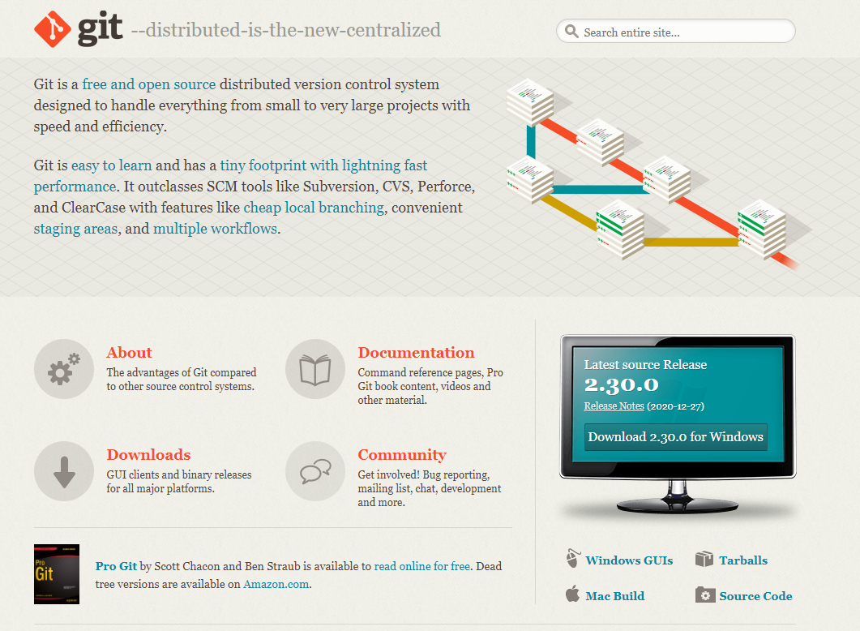
Git
Git is version control system.
Useful for:
  backing up your projects
  Collaboration
Download at: https://git-scm.com/
Website should look like this->
Circled is the download button.

Slide 6
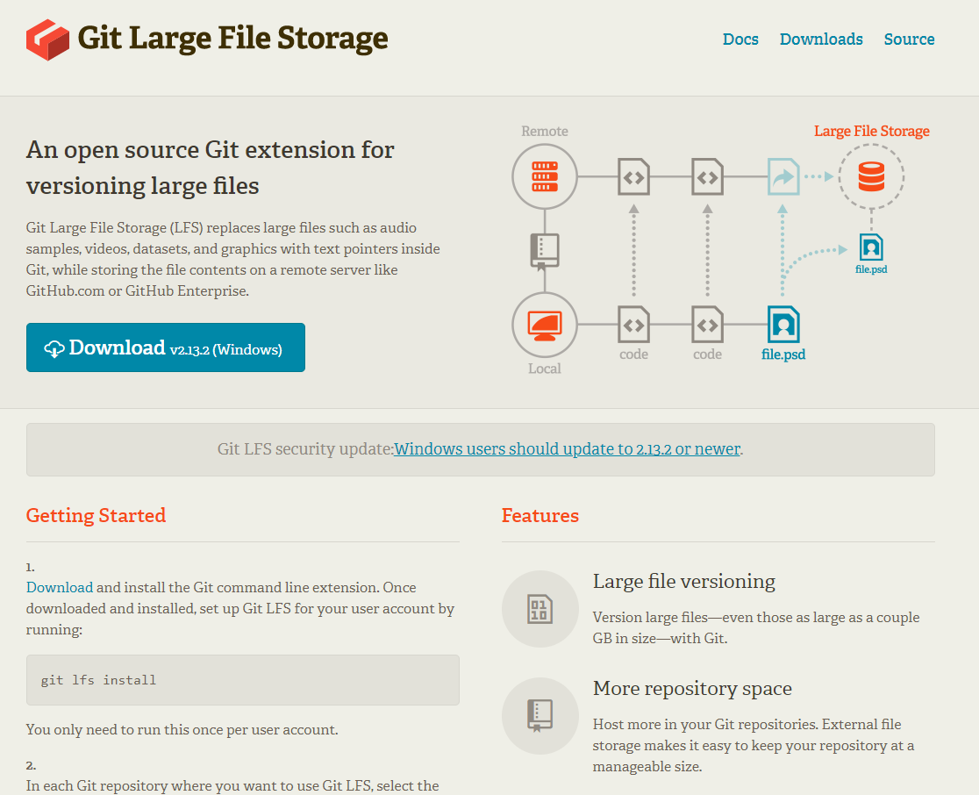
Git LFS
Short for “Git Large File Storage”
Needed for files that are too large for standard GitHub
  GitHub’s limit is 100 MB for a file
Download at: https://git-lfs.github.com/
Website should look like this->

Slide 7
Git LFS Considerations
You only get 1 GB of Git LFS storage and bandwidth for free with GitHub.
After that, it costs $5 / month for every 50 GB of storage and bandwidth you need.
  You can purchase this under “Billing & plans” in your GitHub Account settings.

Slide 8
What are Git LFS Storage and Bandwidth and How is Use Determined?
Storage is used whenever a file is uploaded to the repository.
Bandwidth is used whenever a file is downloaded.
The amount used is based on the files size.
  i.e. a file that is 500 MB will use that amount of your allotted storage and/or bandwidth.
This applies for any small change, so USE WISELY!

Slide 9
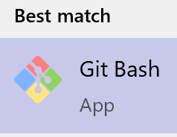
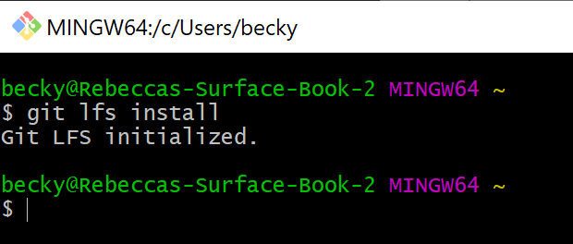
Initialize Git LFS
Using Git Bash (Installed with Git):
  Open Git Bash
  Type: git lfs install
Note: If opening GitHub Desktop it may ask if you want to initialize Git LFS. Accept that as well.

Slide 10
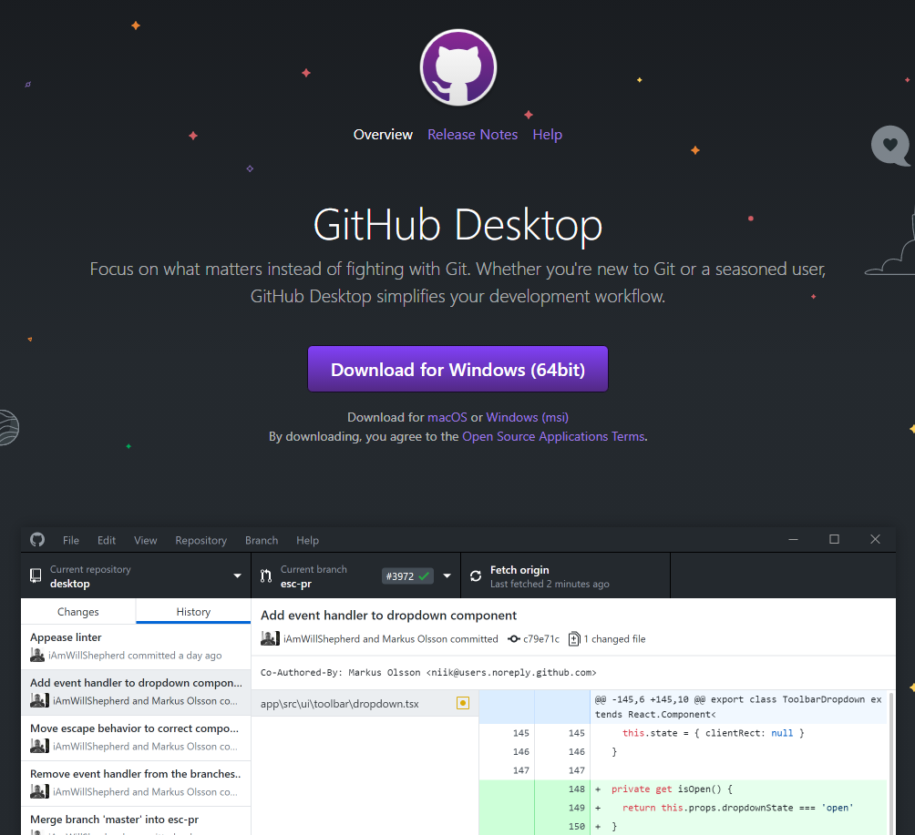
GitHub Desktop (Optional, but Recommended)
If you don’t want to mess with console commands, use this.
Gives a GUI for git and quickly connecting projects with GitHub.
Download at: https://desktop.github.com/
Website should look like this->

Slide 11
Connecting an Unreal Project to Source Control

Slide 12
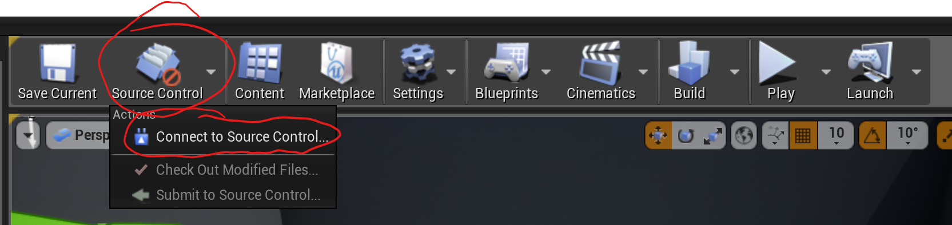
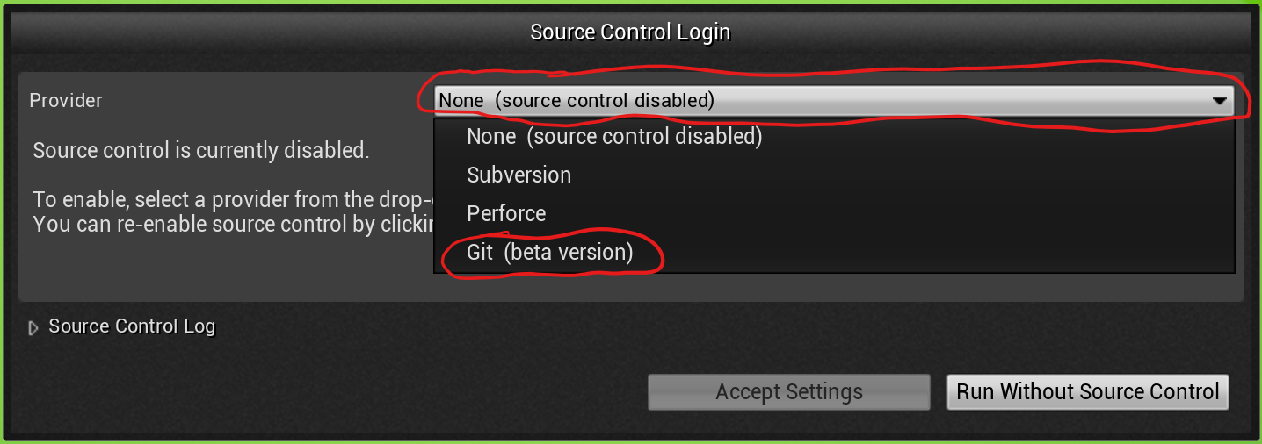
First Time Set Up – Part 1
For any project, fresh or established, open the project and:

Slide 13
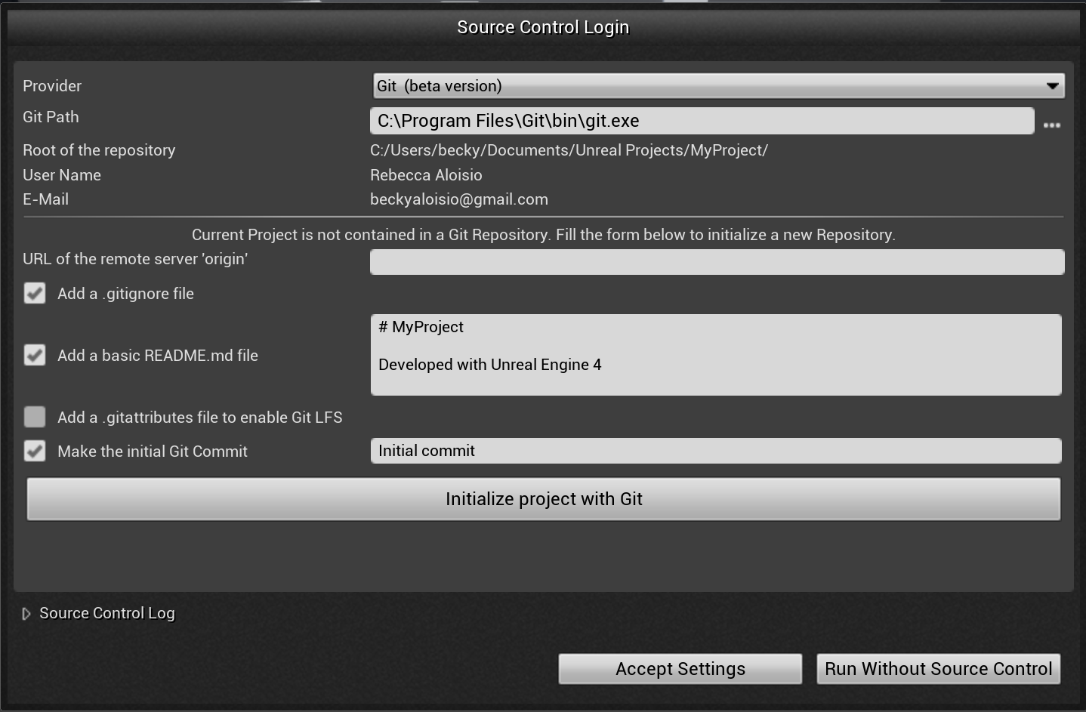






First Time Set Up – Part 2
Make sure this is clicked.
Uncheck this.
If this is not filled, you need to navigate to your installation of git.
Click this
Then this when done.

Slide 14
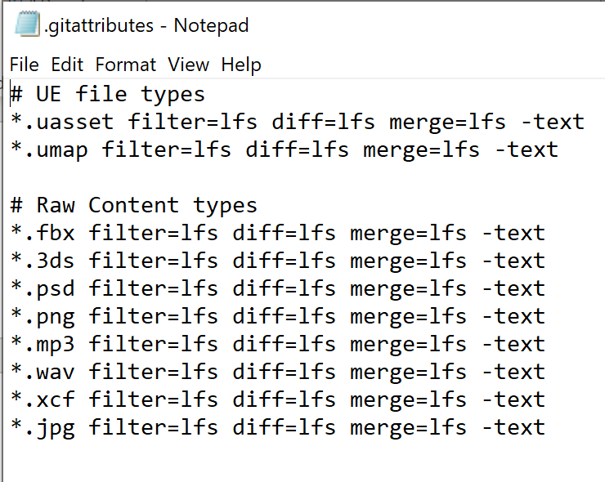
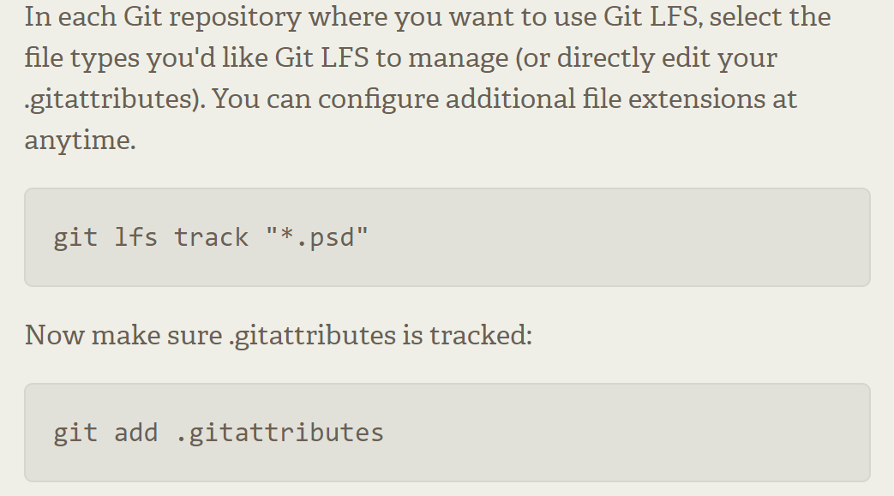

First Time Set Up – Part 3
The “.gitattributes” file contains the settings for Git LFS for a particular project.
If you want the simplest set-up, track the files in the text editor example.
There are two ways to modify the file:
Edit .gitattributes with a text editor.
Using console commands:
Or any file type

Slide 15
Why Modify?
By default, Unreal will set the project to add everything in “Content” to Git LFS.
That means unnecessary files are using precious Git LFS space.
  For greater control of tracking (and storage use), set it to track individual files rather than files of a specific type.

Slide 16
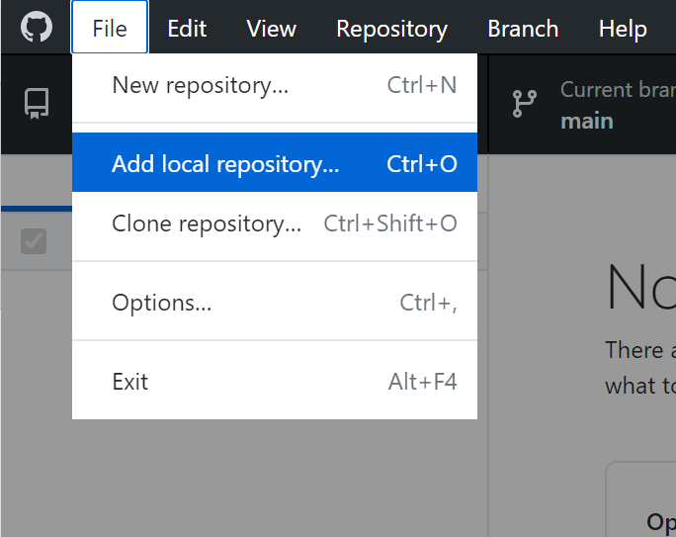
First Time Set Up – Part 4
Save and close out of the project.
Open GitHub Desktop
Click “File->Add a local repository”
Navigate to the game project folder

Slide 17
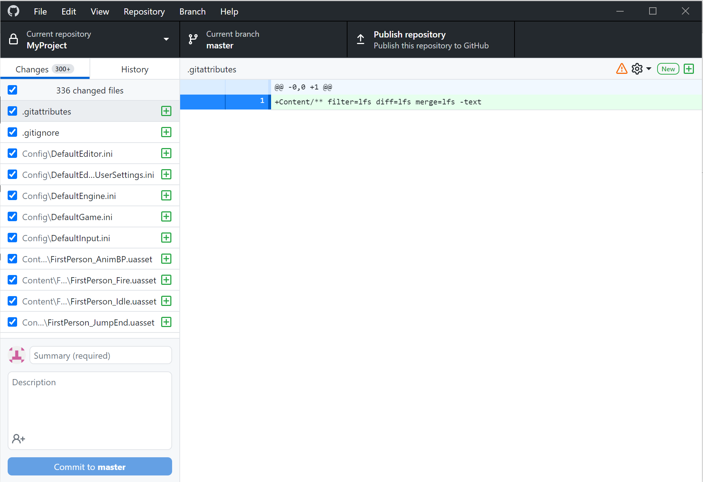



First Time Set Up – Part 5
Uploading your project to GitHub.
You should see something like the side image.
Traditionally, the first commit is called “Initial commit” so type that here
Then click the “Commit to…” button.
Then click the “Publish repository” button.

Slide 18
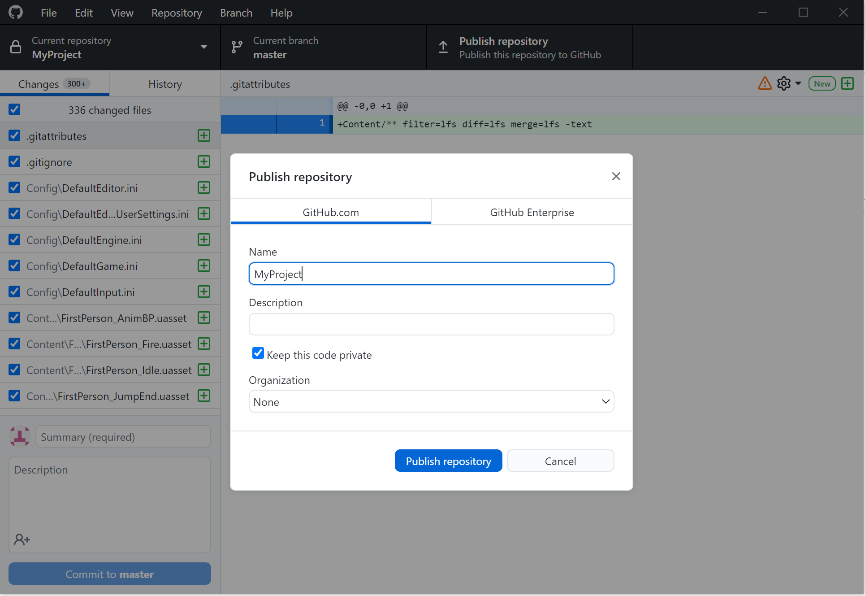
First Time Set Up – Part 6
You’ll get this pop-up.
Leave the “Name” section alone.
“Description” is what will show up in the “About” page of the repository.
“Keep this code private” will determine if you have a public or private repository.
  Look at GitHub’s policy on private repositories before using them.
Click “Publish repository”

Slide 19
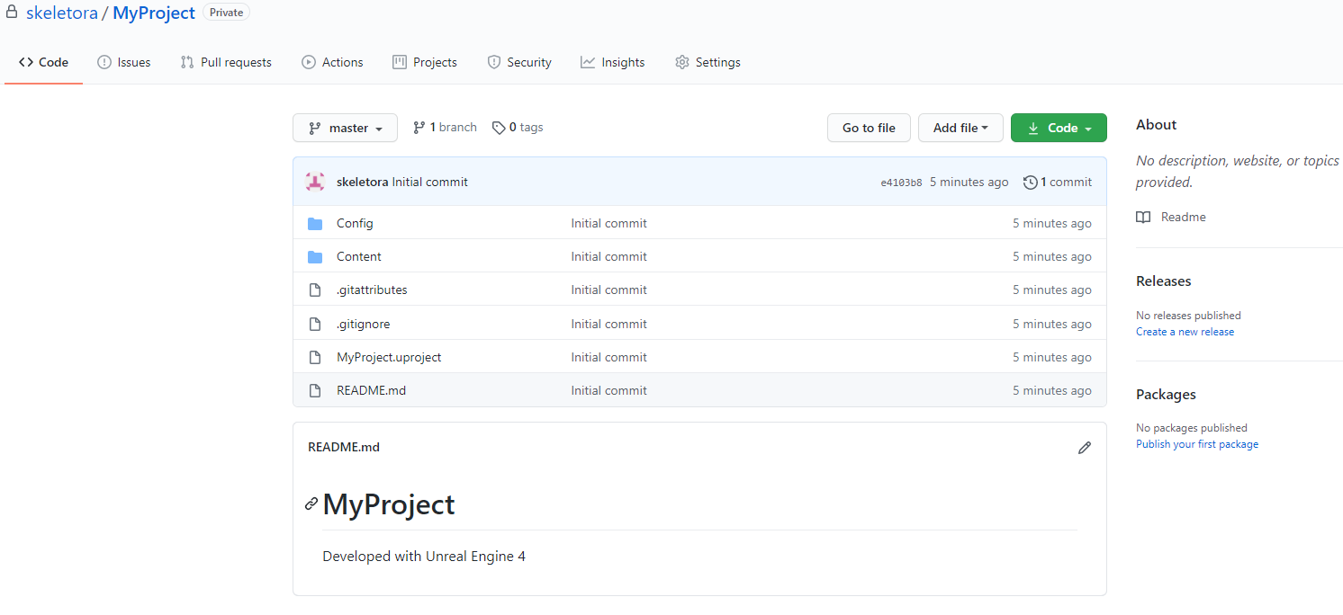
First Time Set Up - Final
You’re done!
Once done uploading, go to https://github.com/ to check that it uploaded okay.

Slide 20
Others Accessing the Project

Slide 21
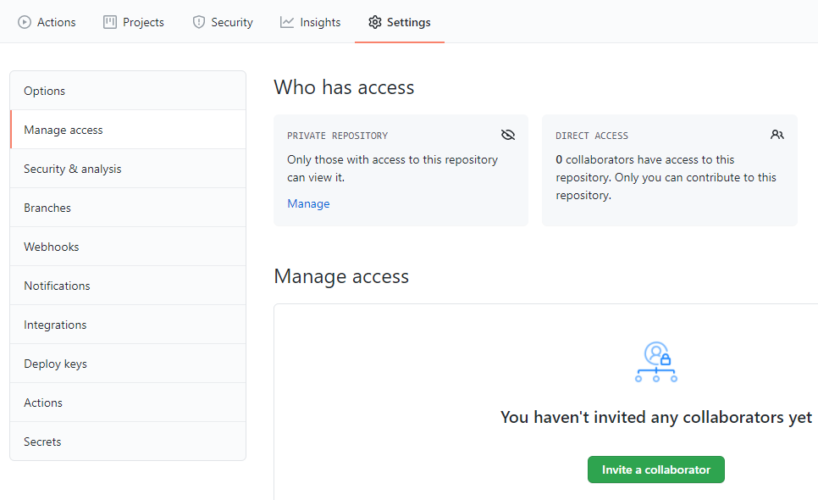
Add Teammates as Collaborators
Only collaborators can modify a project.
Open the project repository.
Go to “Settings”
Click “Manage access”
Click “Invite a collaborator”
Enter their username.
They will receive an email invite.

Slide 22
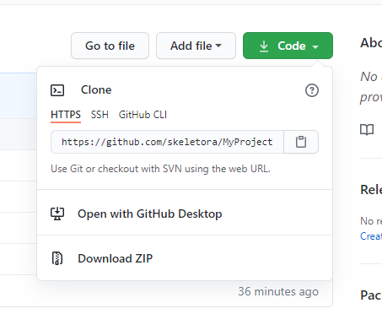
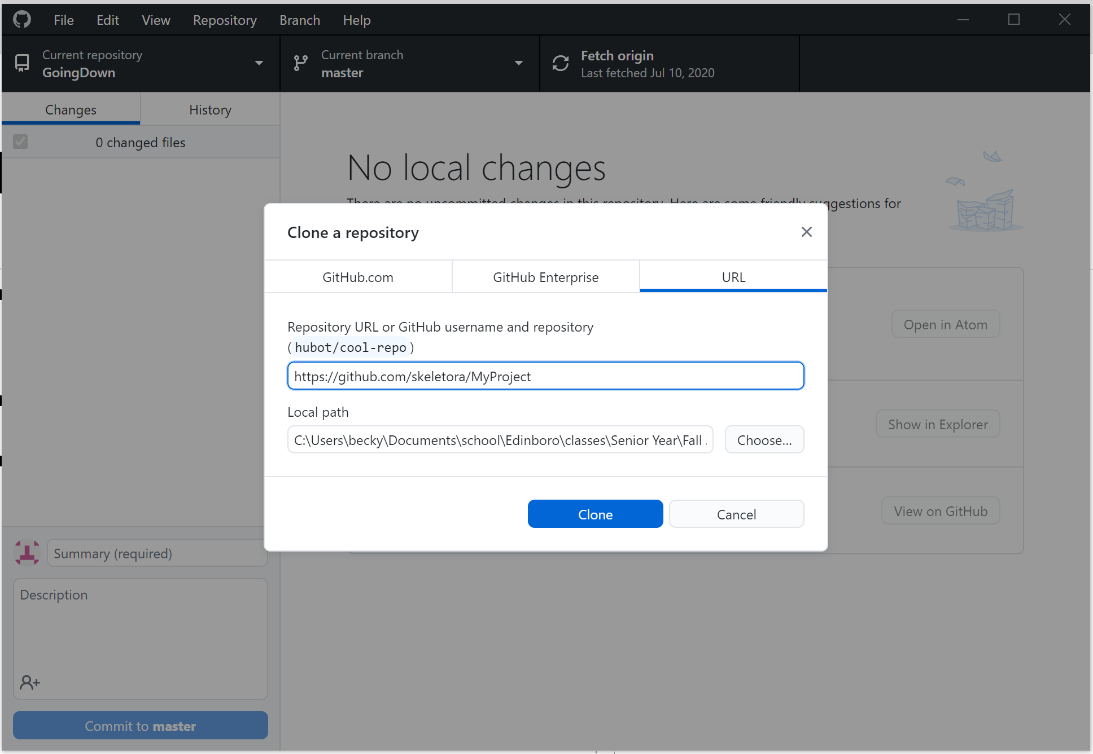

Downloading the Project
Navigate to the project repository on GitHub.
Click the green “Code” button.
Click “Open with GitHub Desktop”
  Give the browser permission.
Set the file location to download the project to here
  It will create a project folder there.
Click “Clone”
Agree to initialize Git LFS.

Slide 23
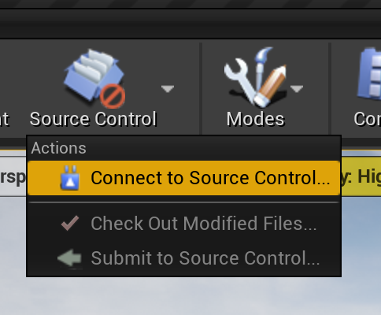
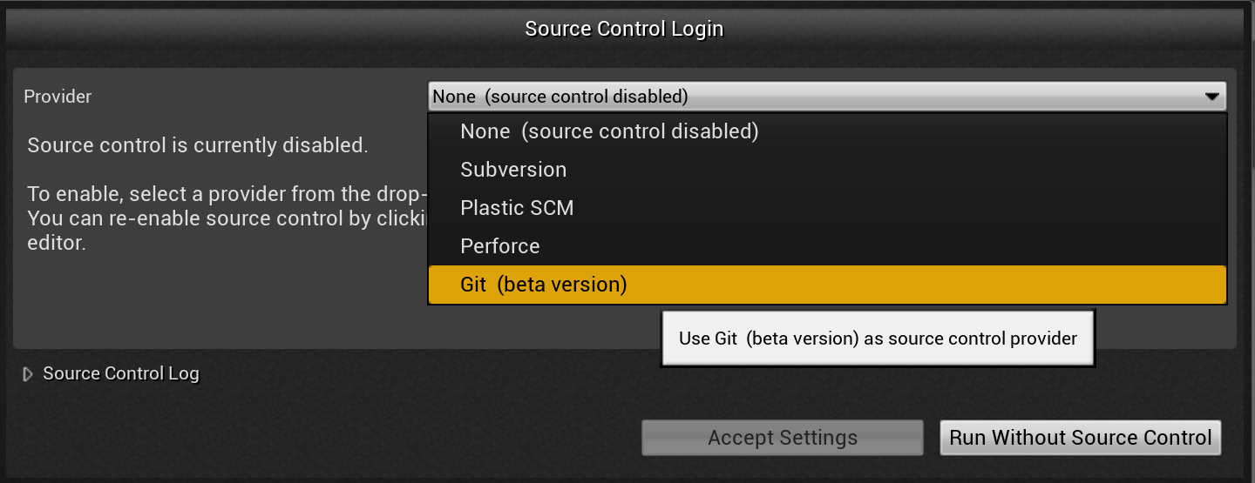
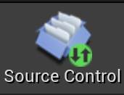
Connect to Source Control
Open the downloaded project in Unreal Engine.
Click “Source Control->Connect to Source Control…”
Select “Git (beta version)” under “Provider”
Make sure it has detected your git installation (just like in the set-up section) and click “Accept Settings”

Slide 24
What Now?

Slide 25
Sharing Changes
Project modifications on your machine are not automatically shared with team.
When ready to upload to GitHub, you have two options:
  Unreal Engine
  GitHub Desktop
I suggest using the Unreal Engine method if the project is still open.

Slide 26
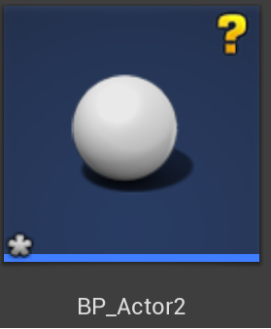
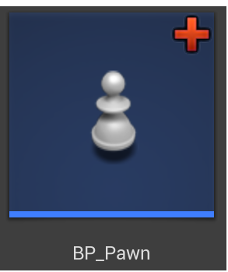
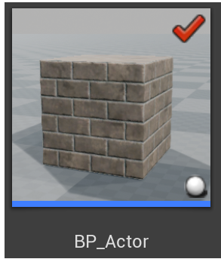
Sharing Changes – Unreal Engine Pt. 1
Changed items should have one of the following symbols in the top right corner:
If they don’t, they won’t be uploaded. They might have this:
If that is the case, then save it.

Slide 27
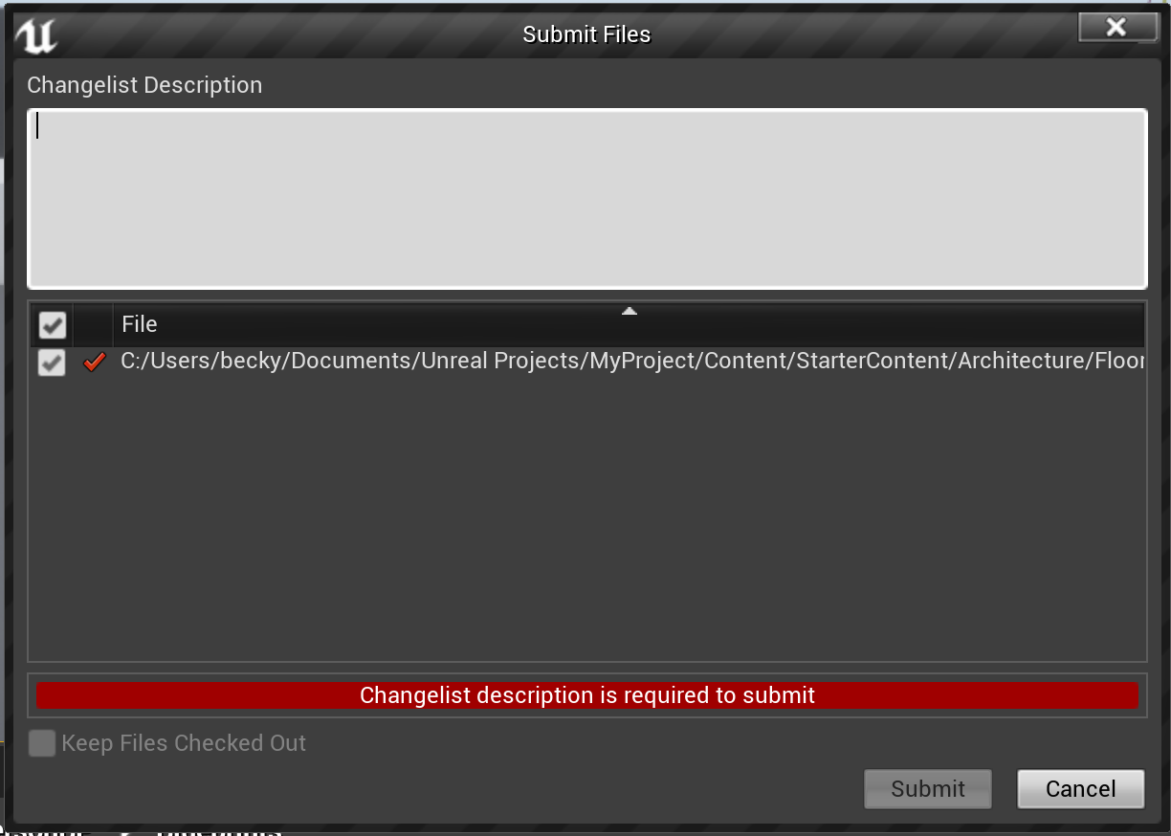
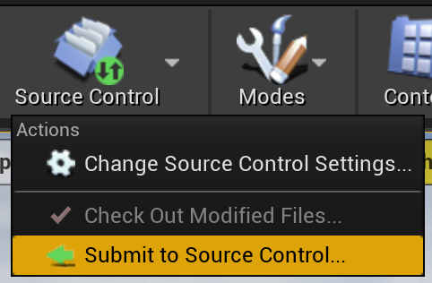



Sharing Changes – Unreal Engine pt. 2
Click “Source Control->Submit to Source Control…”
Enter a description for the commit in “Changelist Description”
Check the files included. Uncheck if you don’t want to include in commit.
Click “Submit” when done.

Slide 28
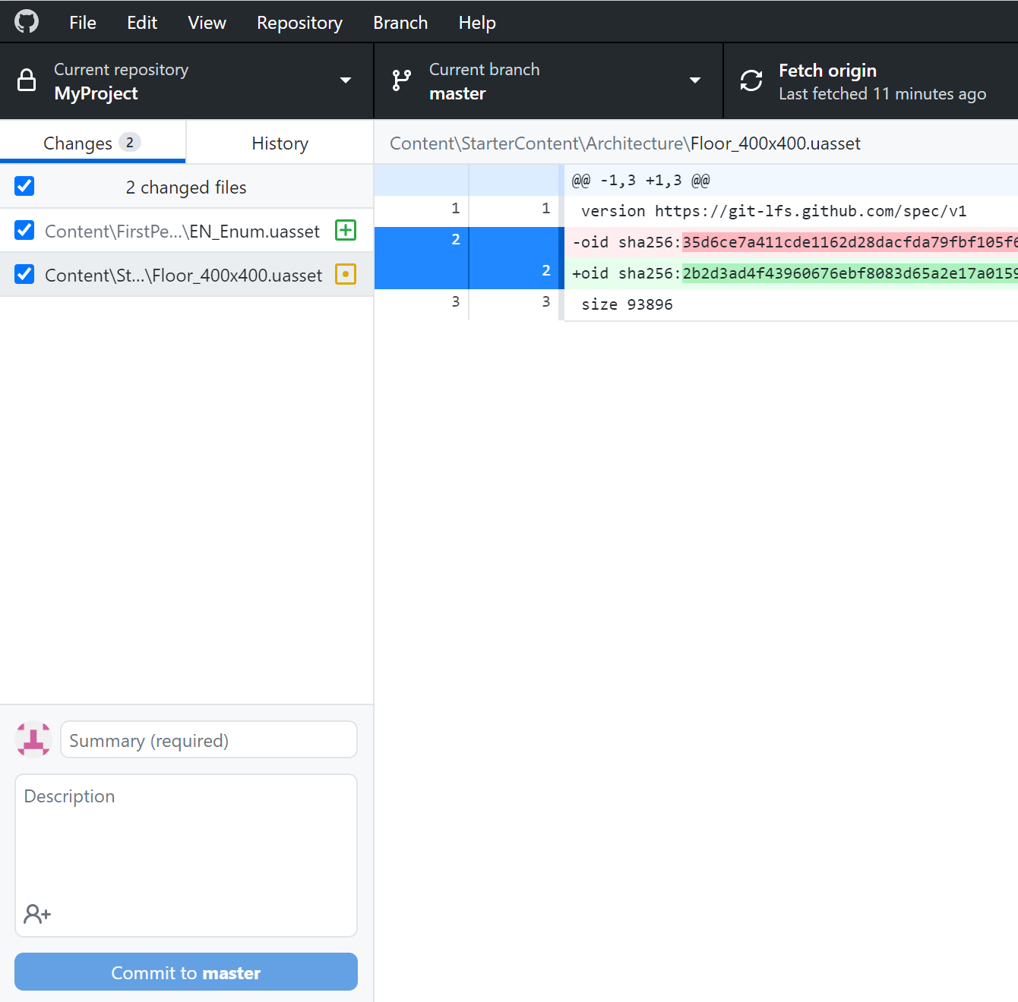




Sharing Changes – GitHub Desktop
Everything that has been changed since the last commit is listed here
  Make sure only the things you want to include are checked.
Type a short descriptor for the commit here
You can give a more detailed description here
Click “Commit to…” when done.

Slide 29
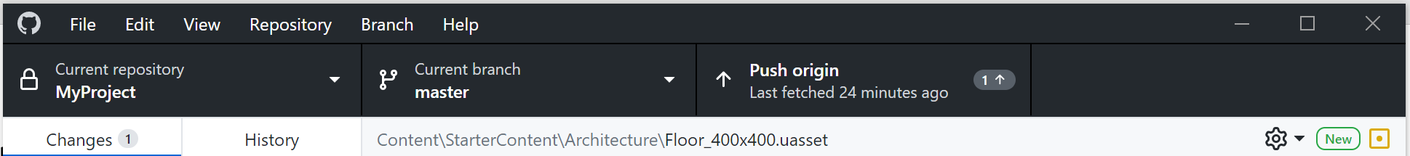
Uploading Those Changes
You need to upload the changes to GitHub.
Open GitHub Desktop (previous method doesn’t matter)
Click “Push to Origin”

Slide 30

Checking for & Downloading Updates
To check for changes, open GitHub Desktop.
Click “Fetch origin”
If there is a change, the button will change to say “Pull origin”
Click the button to download it.

Slide 31
A word of caution
Carefully delegate work.
  If two people are modifying the same portion of the project, you may run into a conflict that can’t be merged. Someone will have to try and resolve that before a merge can go through.
Levels are a pain
  Levels have the greatest tendency to show up in your changes (and therefore commits) when all you may have done is move the camera. Be careful to not include them if you didn’t want them or you may run into a conflict.

Slide 32
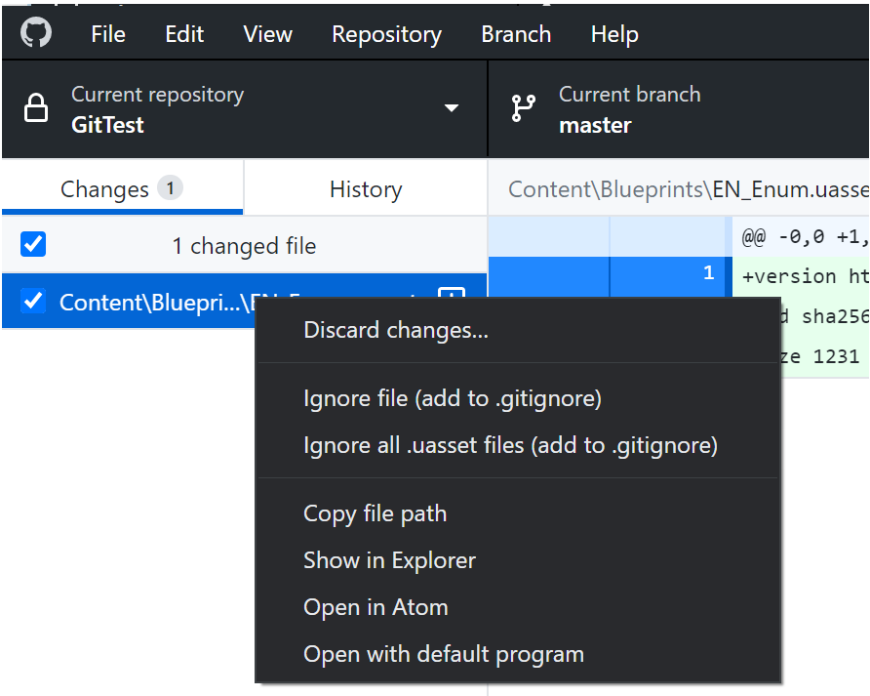
A fix that sometimes works
If changes are popping up that you didn’t do, there is a way to discard them.
CLOSE OUT OF THE PROJECT.
Open GitHub Desktop
Right-click on the offending object
Click “Discard changes…”
This can prevent future conflicts.

Slide 33
Advanced topics
Primarily relating to git and github

Slide 34

Branches – pt. 1 – What are they?
Branches are a way divide a project up to safely test and implement features.
You have your “main” or “master” branch.
  This is the tree trunk of the project that all other branches shoot off from.
Then you have custom side branches.
Side branch
Side branch
Side branch
Side branch
“main” or “master” branch

Slide 35
Branches – pt. 2 – How they connect
Functionally, branches are like separate copies of your project.
Creating a branch from another branch (i.e. “main”) makes the new branch a copy of the previous.
Branches cannot access anything exclusive to another branch.
  i.e. branch “menus” has the main menu. The branch “player” doesn’t so it cannot access the main menu.
“main” or “master”
Menus
Levels
Player

Slide 36
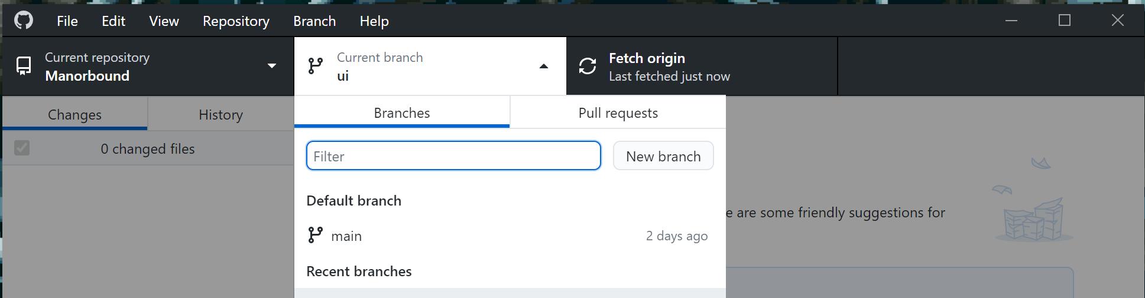
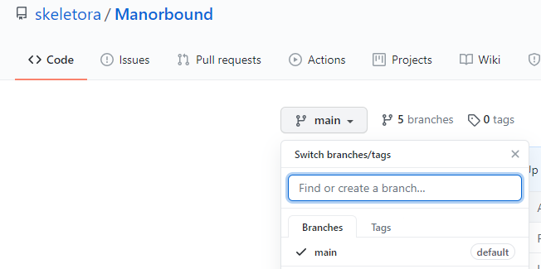
Branches – pt. 3 – Making a branch
GitHub Desktop
  Click “Current branch”
  Type the name in “Filter”
  Click “New branch”
  Click “Publish branch” (it will change)
GitHub
  Under “Code” click “main” or “master”
    Note: this may have a different branch name. Make sure it says “main” or “master”
  Type the name of the branch
  It should now be listed on GitHub Desktop

Slide 37
Branches – pt. 4 – their use
The “main” or “master” branch should be treated as the current working version of the project.
All other branches are used for implementing and testing new features before adding them to “main” or “master.”
  Ex. Testing out a double jump for the player class before adding it to the “main” or “master” branch.
What do you do when you are done implementing and testing on a branch? Afterall, branches can’t access each other.
  You submit a “pull request.”
This can be done with GitHub or GitHub Desktop.

Slide 38
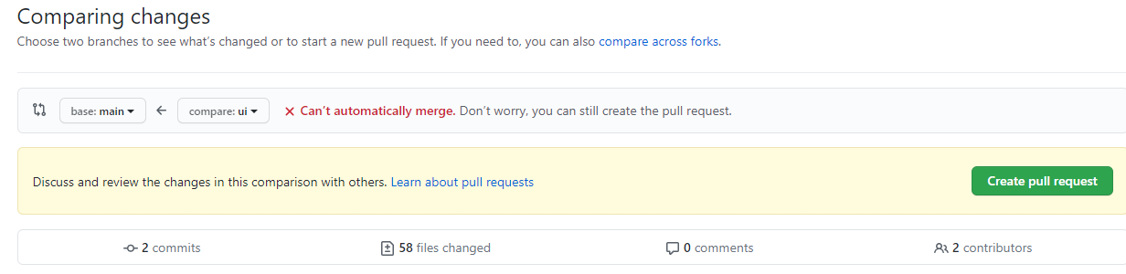
Branches – final - merging
GitHub Desktop
  Switch to the branch
    Click “Current branch” and select the branch
  Click “Create Pull Request”
  You’ll be taken to github.com
  Fill out info
  Click “Create pull request”
  Someone will then need to go in an apply the pull request
GitHub
  Click the “Pull Requests” tab
  Click “New pull request”
  The “compare: <branch>” tab is the branch that is being merged into “base: <branch>”
  You want a green “Able to merge”
    If you don’t, you have a conflict.
  Click “Create pull request” when done.

Slide 39
Questions?

